Slide 1
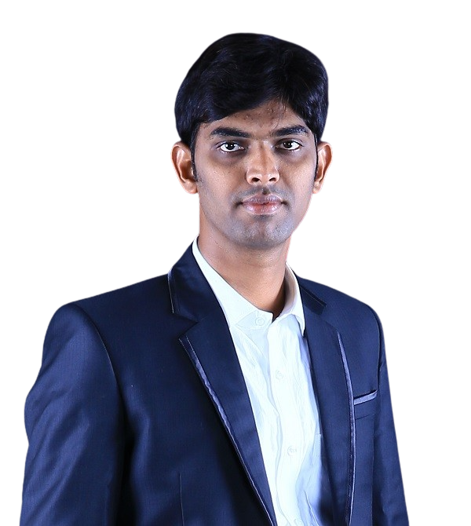
Option 1
Mahaboob Basha has joined us as a Manager Data Analytics and brings over 10 years of experience in the life sciences field. He can provide insights into Phase I, Phase II, and Phase III data to help with decision-making in clinical trials, the commercial life sciences industry, and operational performance metrics (CoE). He was connected to Labcorp, IQVIA, Quartesian, and CIAI (Commercial life sciences start-up) before joining GSK. He enjoys delving into business problems and developing one-of-a-kind, user-centric solutions using BI tools and AI/ML approaches. Furthermore, using AI/ML methodologies, a proof of concept of facial signature and voice-based BI tool integrations was successfully built. He also enjoys cricket, chess, and reading.

Slide 2
Welcome to the CMDA – Data Analytics Team
Option 2
Mahaboob Basha has joined us as a Manager Data Analytics and brings over 10 years of experience in the life sciences field. He can provide insights into Phase I, Phase II, and Phase III data to help with decision-making in clinical trials, the commercial life sciences industry, and operational performance metrics (CoE). He was connected to Labcorp, IQVIA, Quartesian, and CIAI (Commercial life sciences start-up) before joining GSK. He enjoys delving into business problems and developing one-of-a-kind, user-centric solutions using BI tools and AI/ML approaches. Furthermore, using AI/ML methodologies, a proof of concept of facial signature and voice-based BI tool integrations was successfully built. He also enjoys cricket, chess, and reading.

Slide 3
